Slide 1
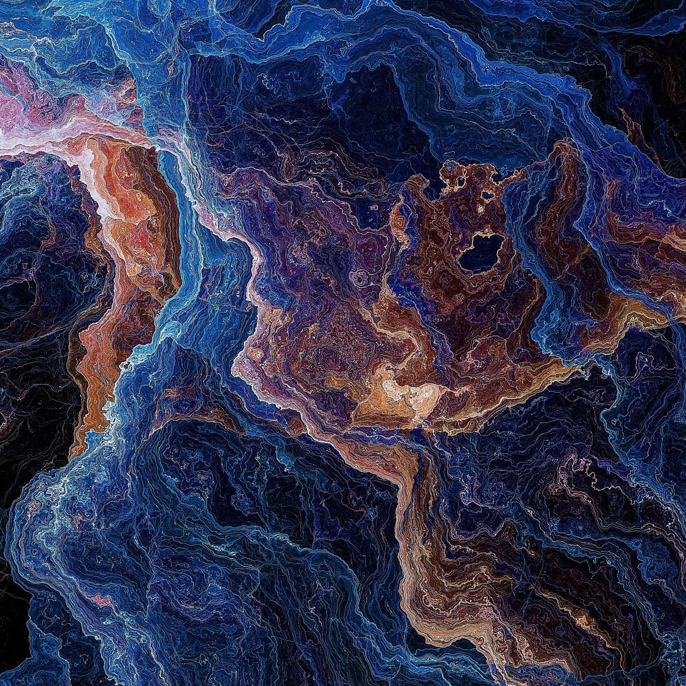
Julia Hackathon Challenge: High Performance Ocean Internal Wave Detection
Arun Kumar Shukla
Data Science Developer,
Atlantic International Research Centre, Azores, Portugal

Slide 2
Objective
Build a high-performance Julia Pipeline for Ocean Internal Wave Detection
Challenge: Improve the existing Python-dependent machine learning pipeline into a high-performance Julia implementation.
Mandatory:
Improves AUC-ROC from 0.89 to >0.95
Reduces execution time from 1 hour to under 10 minutes
Adds GPU acceleration
Desirable:
Eliminates all Python dependencies

Slide 3
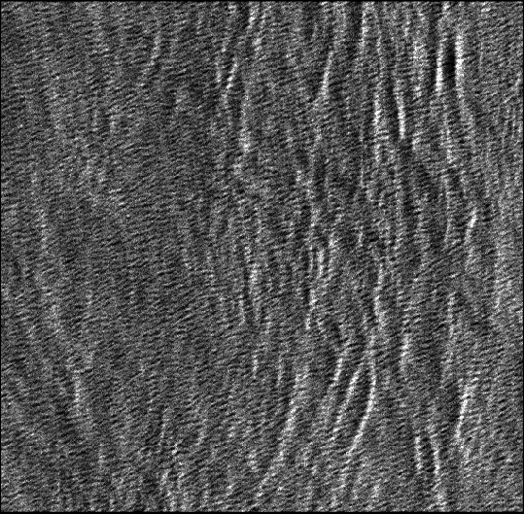
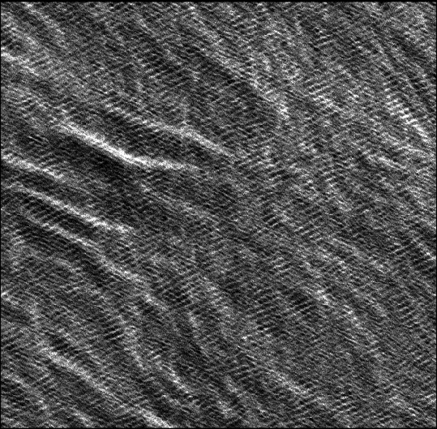
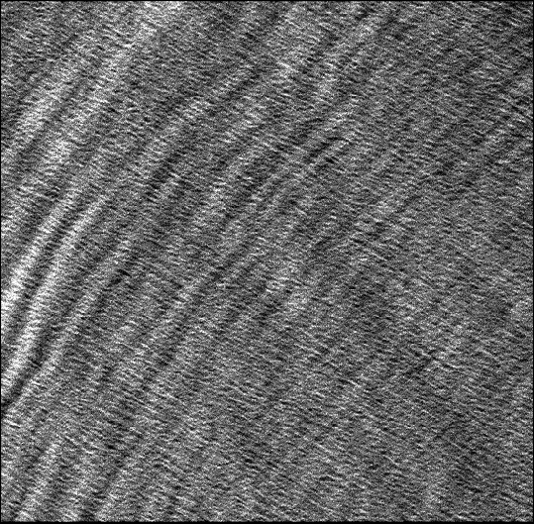
Dataset
19,528 Sentinel-1 Wave(WV) Mode satellite images
13,668 training + 5,860 test images (50% +ve and 50% -ve samples)
224×224 resolution, RGB format
Processing Requirements Images → Feature Extraction → Classification → Predictions

Slide 4
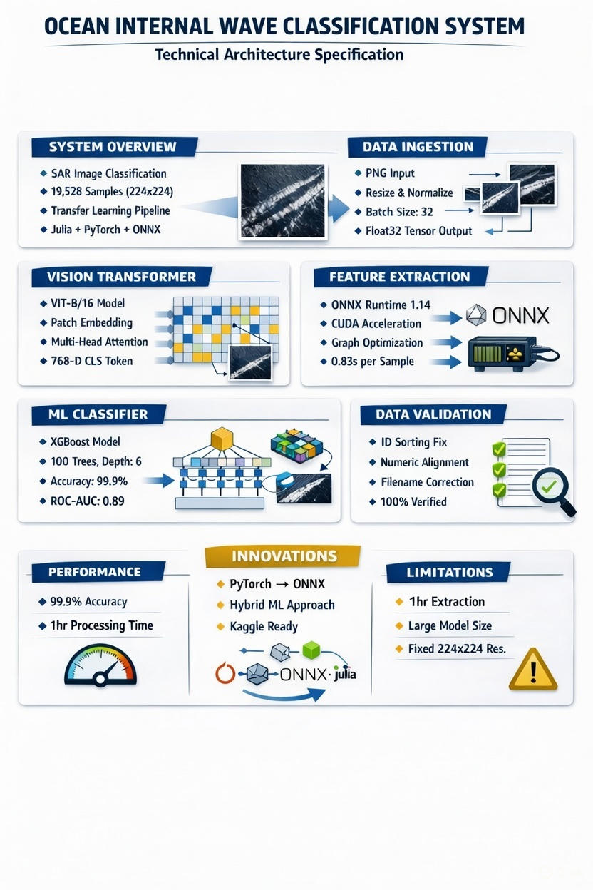

Slide 5
The Existing Pipeline (What I Built)
Four Main Components:
Feature Extraction (extract_features.jl)
Hybrid Julia/Python with ONNX runtime
Handles GPU/CPU switching
Extracts 1000 features per image
Data Alignment (fix_data_alignment.jl)
Solves ID mismatch problem
Creates translation between systems
Critical for correct training
Model Training (train_final.jl)
XGBoost with GPU support
Cross-validation with AUC monitoring
Regularization to prevent overfitting
Prediction (predict.jl)
Generates competition submissions
Probability clipping and validation
Ready for deployment

Slide 6
Current Performance Analysis
Where We Stand Today
Model Performance:
Cross-validation AUC: 0.8905 ± 0.0005
5-fold stratified validation
Strong regularization applied
Predictions: 100% wave classification (imbalance issue)
Computational Performance:
Feature extraction: ~1 hour (CPU)
Training: ~42 minutes
Inference: ~15 minutes
Memory: ~12 GB peak usage
Known Issues:
Class imbalance not fully addressed
GPU acceleration partially implemented
Pipeline could be more efficient

Slide 7
The Problem Statement
Classify Satellite Images for Internal Waves
What: Detect ocean internal wave patterns from satellite imagery Why: Important for oceanography, climate studies, marine navigation Dataset: 13,668 training images, 5,860 test images Format: PNG images → 1000-dimensional feature vectors
Starting Performance Metrics:
Current AUC: 0.8905
Runtime: ~1 hour (CPU)
Your Challenge: Take my working code and make it better!

Slide 8
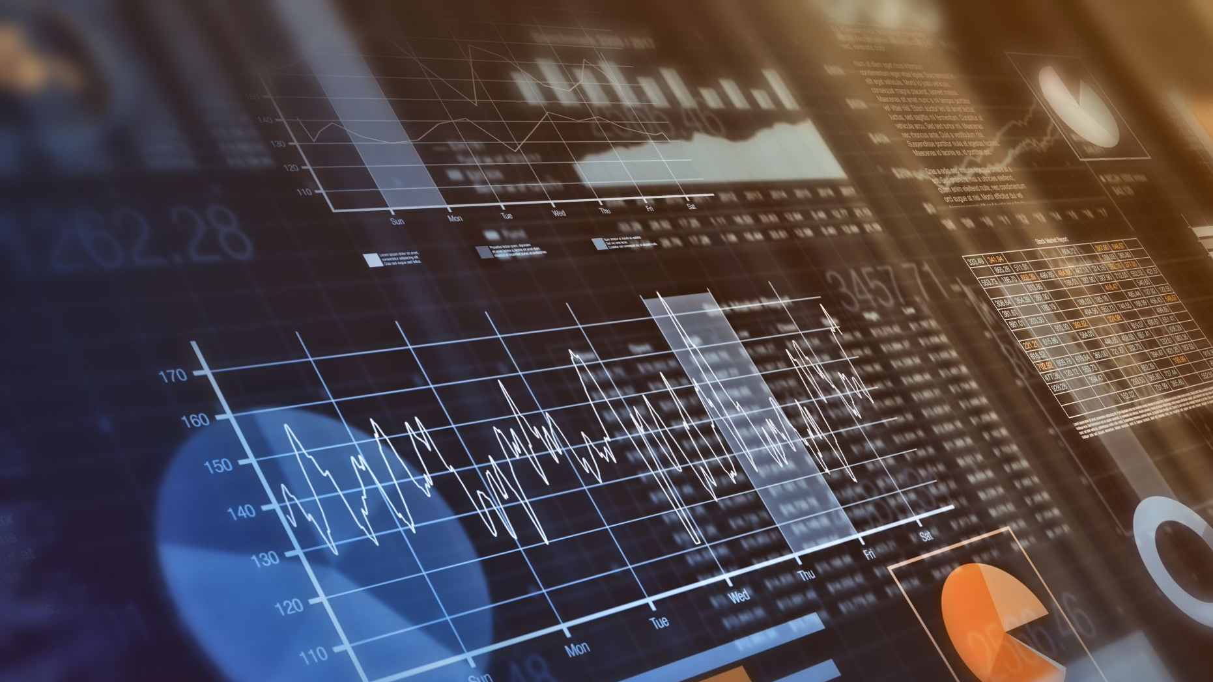
Available Code Base Repository Structure:
├── data/ # Features, labels, test data
├── models/ # Pre-trained models
├── scripts/ # Complete pipeline
│ ├── extract_features.jl # Feature extraction
│ ├── fix_data_alignment.jl # ID translation
│ ├── auc_roc_cv.jl # Validation
│ ├── train_final.jl # Model training
│ └── predict.jl # Prediction
├── results/ # My results
└── README.md # Setup instructions

Slide 9
Optimization Opportunities
Areas for Improvement
Model Accuracy:
Goal: Improve AUC from 0.89 to >0.98
Approaches: Address class imbalance, better features, ensemble methods
Performance Optimization:
Goal: Reduce total runtime from 1 hour to <10 minutes
Approaches: Better GPU utilization, parallel processing, optimized batches

Slide 10
Technical Stack & Constraints
What You Can Use
Required:
Julia 1.9+ (primary language)
My existing code base as starting point
Available:
GPU access (CUDA.jl compatible)
ONNX models for feature extraction
XGBoost.jl for classification
Full dataset (13K training, 5K test)
Constraints:
Must maintain competition submission format
Need reproducible results
Should be able to run on standard hardware
Evaluation: Based on AUC improvement, runtime reduction, and code quality

Slide 11
Hackathon Structure
Monday-Friday Schedule
Monday:
Introduction & setup
Understanding the pipeline
Initial baseline runs
Tuesday-Thursday:
Team work on optimizations
Mentor support available
Progress check-ins
Friday:
Final presentations (10 min each)
Live Code demonstrations
Technical discussions
Submission Requirements:
Optimized code
Performance metrics (AUC, runtime)
Brief presentation
Documentation of improvements

Slide 12
Learning Outcomes & Next Steps
What You'll Gain
Technical Skills:
Julia ML pipeline optimization
GPU acceleration techniques
Handling real-world data challenges
Production ML engineering
Research Skills:
Debugging complex ML pipelines
Performance benchmarking
Experiment design and validation
Documentation and presentation
Community Benefits:
Learn from my working implementation
Share improvements with others
Build network with Julia ML practitioners
Contribute to open-source ML in Julia
Final Goal:
Everyone leaves with better Julia ML skills and potentially publishable optimizations!

Slide 13
Thank you
Contact email: arun.shukla@aircentre.org

